Slide 1
Auction App
Team 9
Thomas Duncan
Ryan Egbert
Joshua Handschin
Warren Novascone

Slide 2
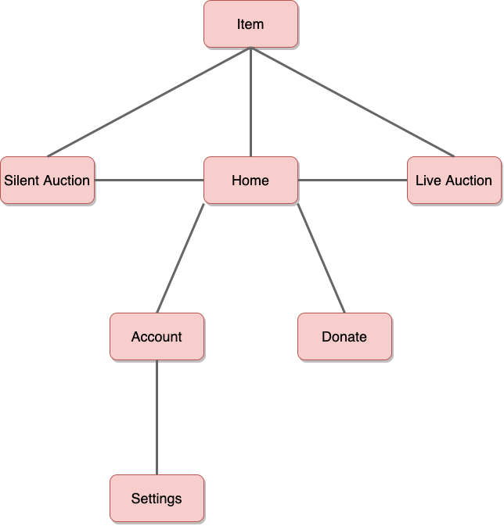
Navigation Tree

Slide 3
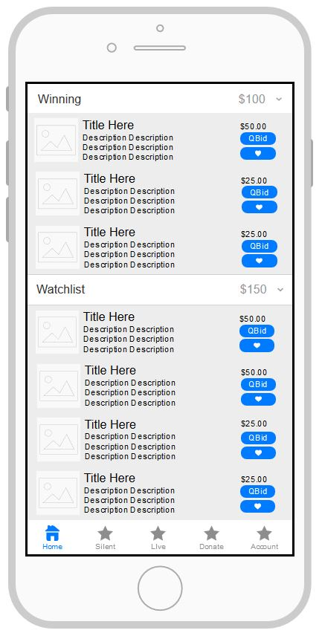
Home Page
Prototype

Slide 4
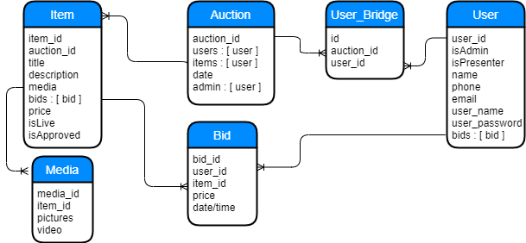
Database Schema

Slide 5
Frameworks
Firebase
Firebase is an easy to use framework for developing web apps
It scales automatically and allows for google analytics and testing to be integrated seamlessly
Vue.js 2
Vue.js 2 is used to build user interfaces and single page apps

